Slide 1
Integration Strategy Definition Approach

Slide 2
Integration Strategy Influencers
Business Context
Existing Business Processes, Business strategy and key desired outcomes expected of the integration strategy
IT Context
Current integration maturity state, overall IT landscape, integration patterns, Architecture and Governance Principles, future IT strategy and desired outcomes of integration strategy
Integration Strategy
Industry Trends
Current and emerging Business and Integration Technology trends and their applicability to the key business requirements of the Enterprise
Business & IT Tactical Concerns
Immediate Business and IT requirements and concerns that are critical due to the benefits they provide in short-term

Slide 3
approach for Integration Strategy Definition
Target State Of Integration
Achieved By
Business & It Tactical Concerns
To Identify
Inputs for
Defines
Integration Strategy Drivers & Objectives
Gap Analysis & Implementation Roadmap Definition
Integration Strategy
Industry Trends
Integration Strategy Options
Finalized Integration Strategy
Technology
Governance
Architecture
Charter
Operating Model
Benefits & Feedback
Prioritized For
Evaluated
Enabling Platform
Governance Model
Metrics
IT Context
Integration Strategy Guiding Principles
Implementation*
To Shortlist
To Derive
*This is not part of the Integration Strategy Definition
Business Context
Technology Track
Focuses on defining the to-be integration platform(Contextual and Capability views), capability gap analysis and how the required integration patterns will be realized in the target integration platform
Governance Track
Focuses on defining the target operating model and governance model for implementation of integration strategy. Identifies working groups and their responsibilities to further the implementation of Integration Strategy

Slide 4
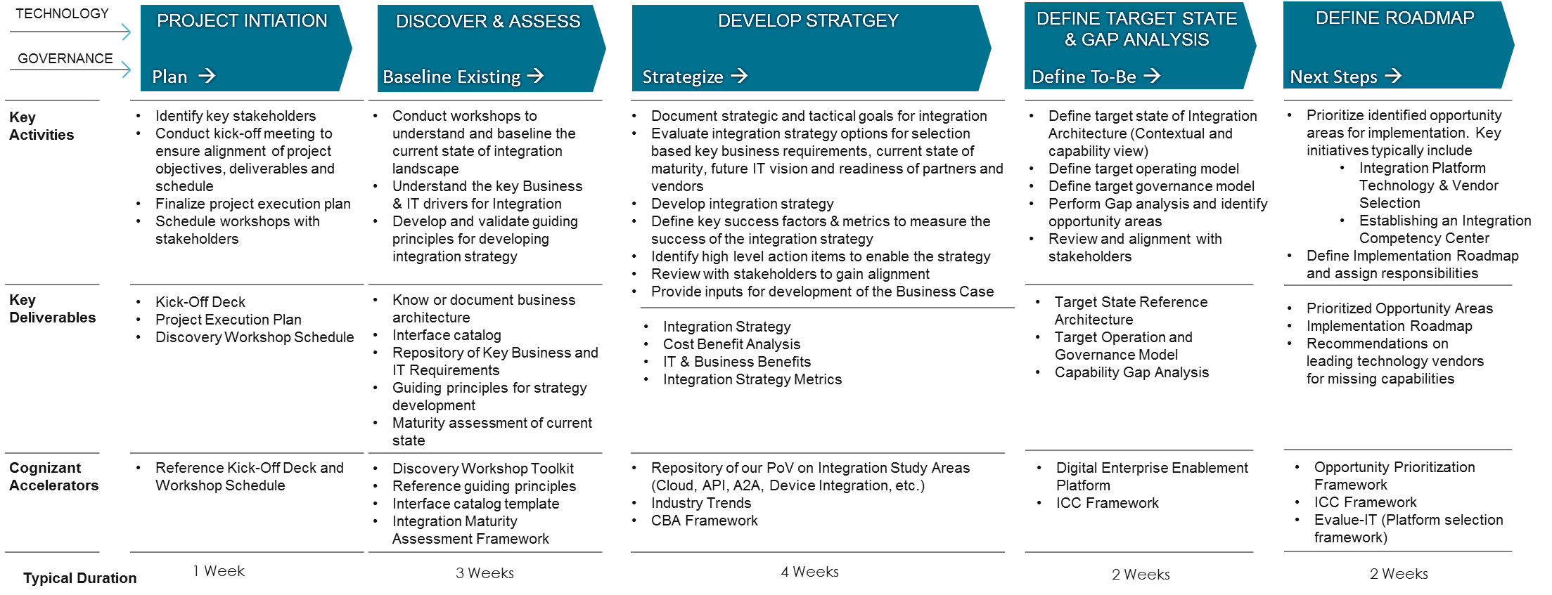
Integration Strategy Definition Methodology
Cognizant offers a comprehensive solution for Integration strategy definition taking into consideration technology as well as Governance aspect of Enterprise Integration
Duration mentioned above is indicative and varies with the scope (the dimensions to be covered) scale and priorities of the Enetrprise

Slide 5
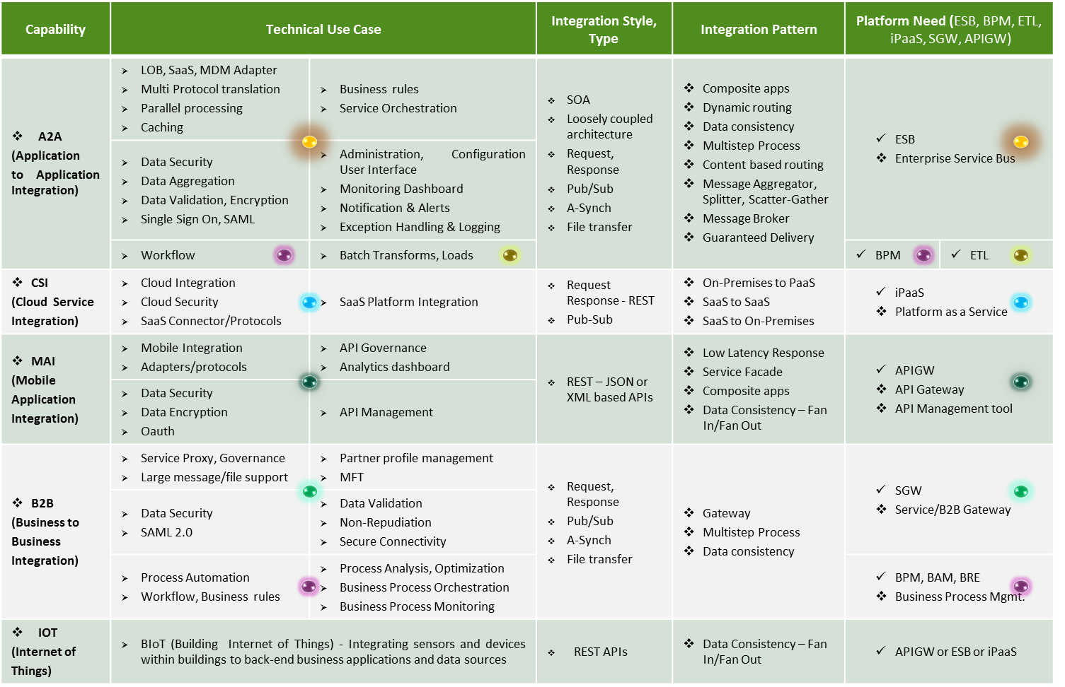
Sample Deliverable | Integration Capability Reference Map

Slide 6
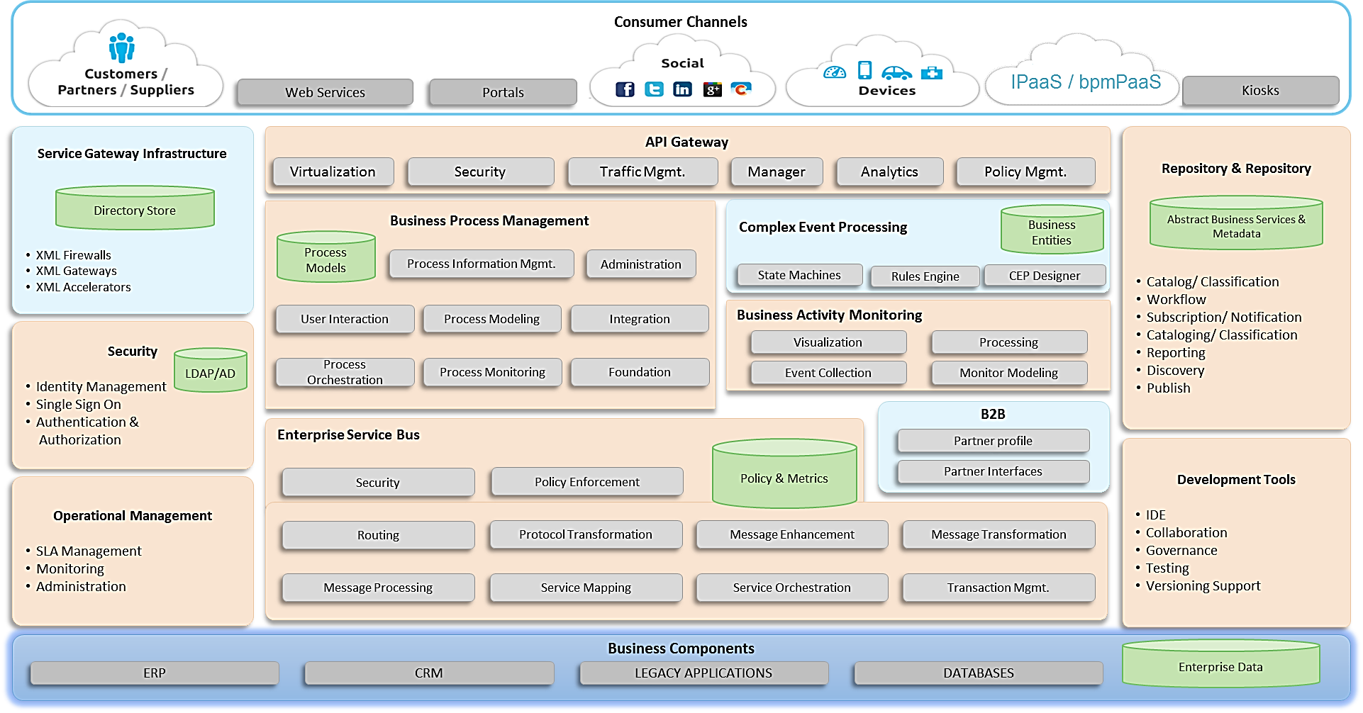
Sample Deliverable | Target State Reference Architecture

Slide 7
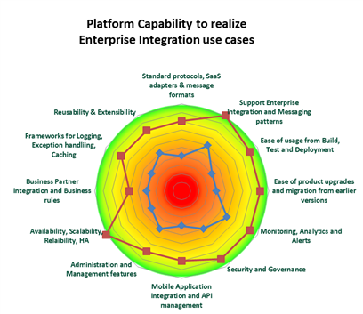
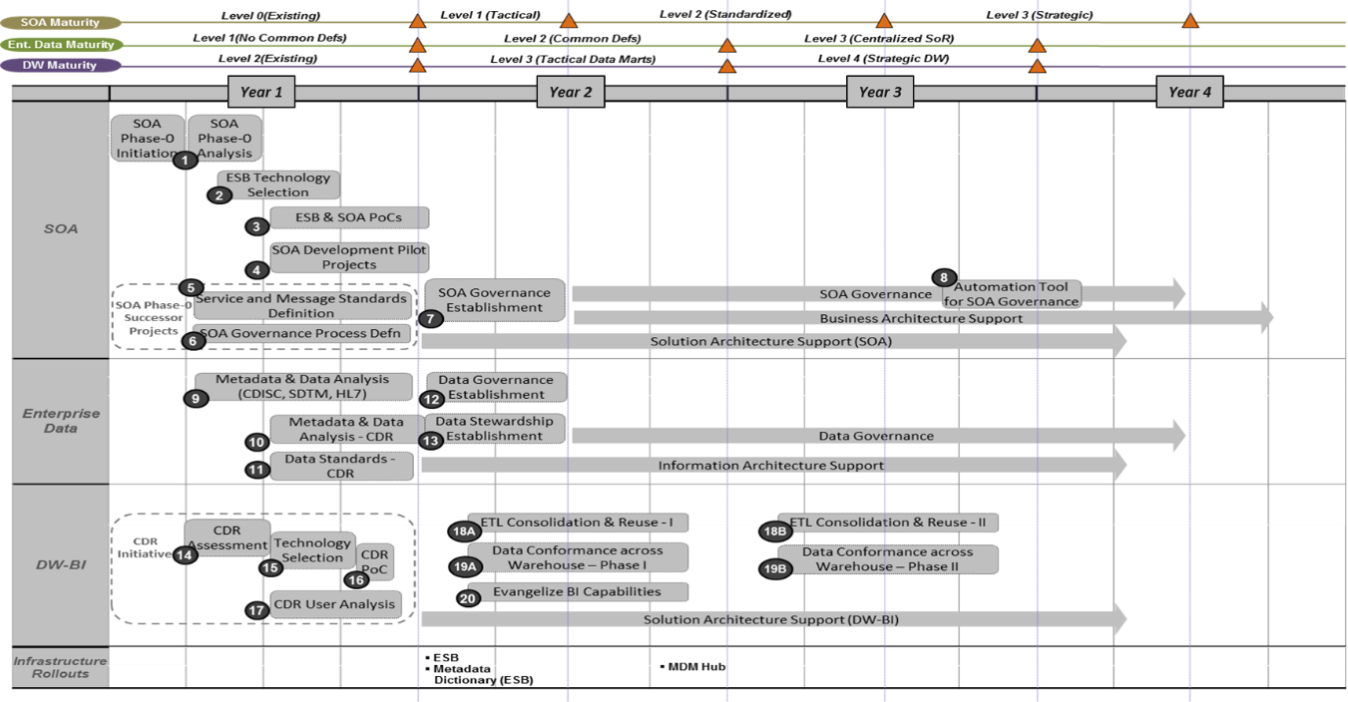
Sample Deliverables
Implementation Roadmap

Slide 8
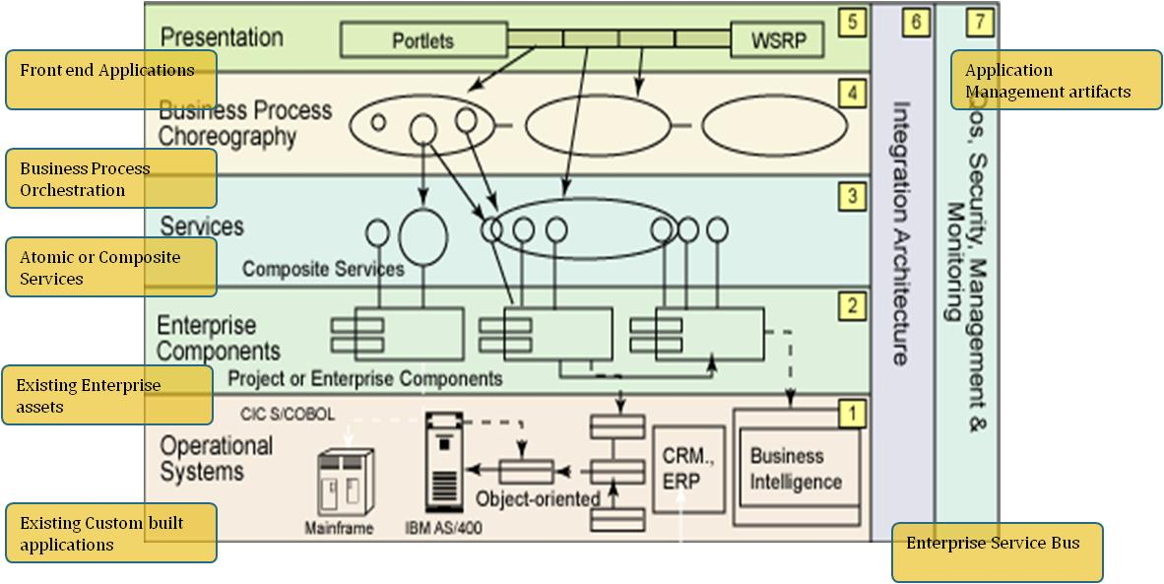
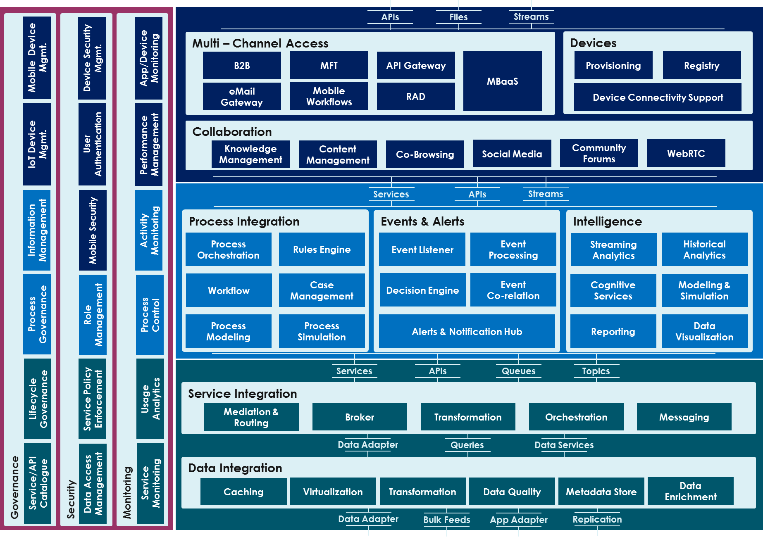
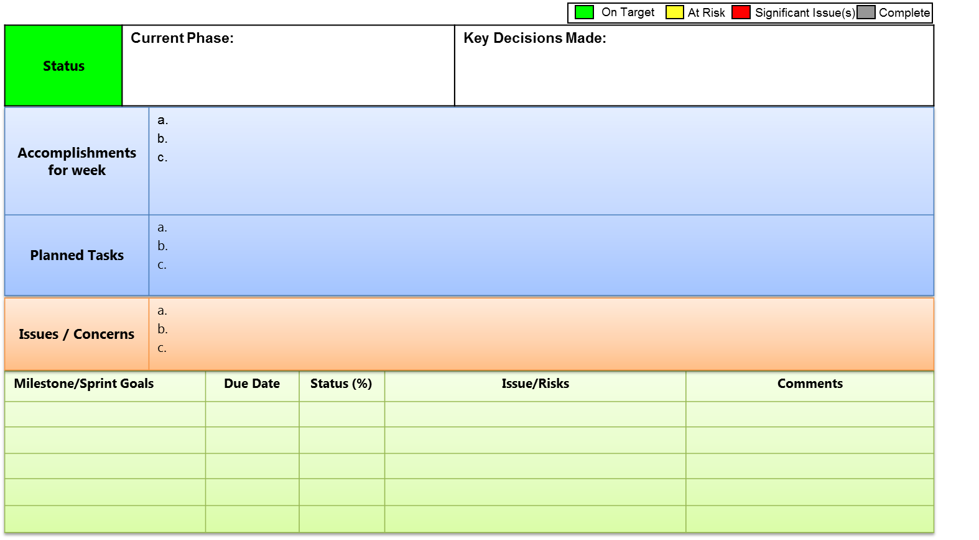
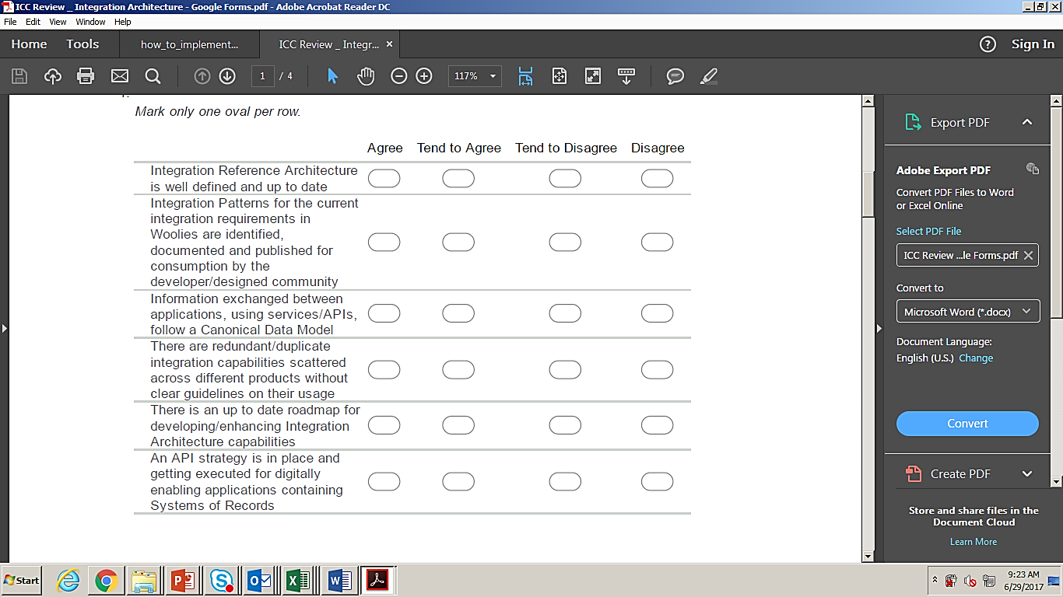
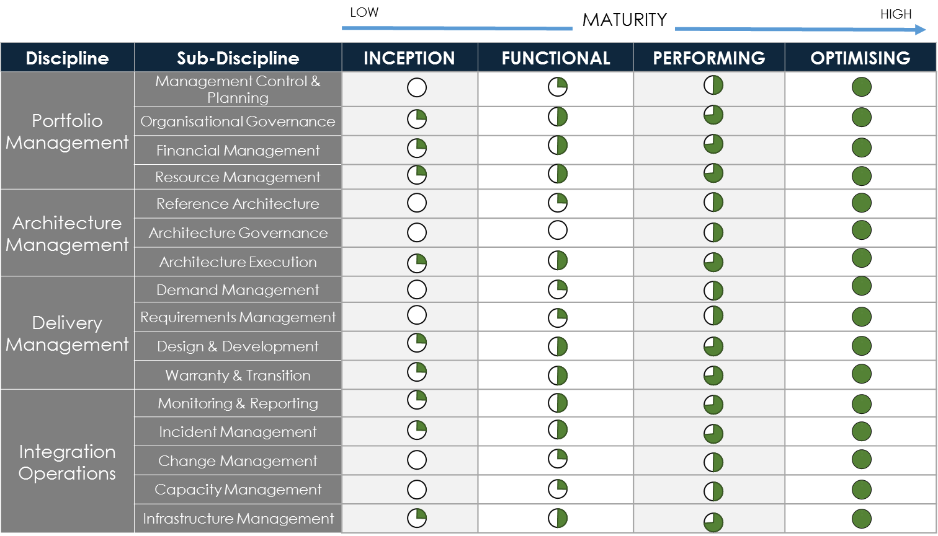
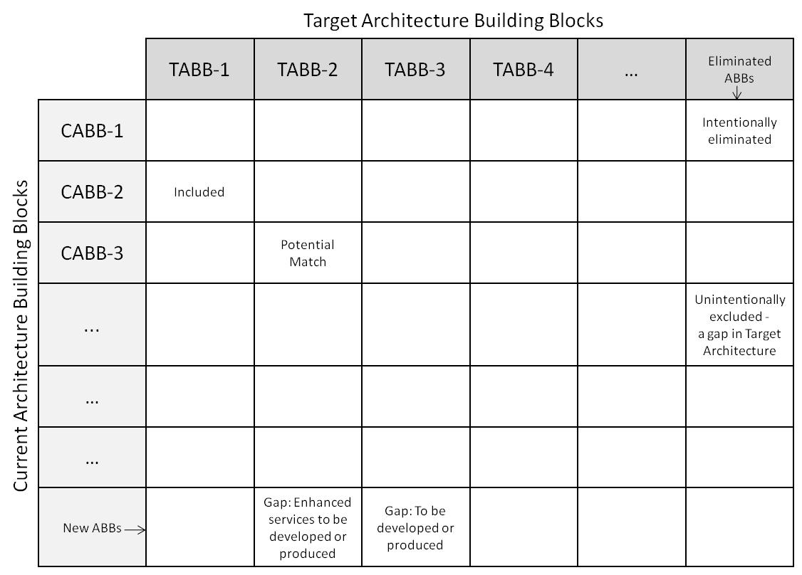
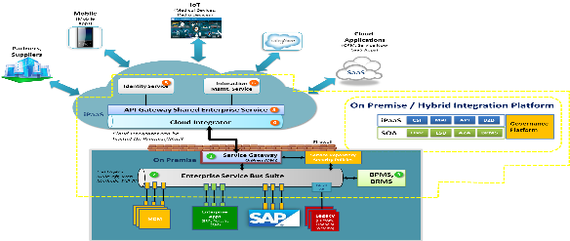
Frameworks and Accelerators
Questionnaires
Frameworks
Reference Architecture
Templates
SOA Conceptual Reference Architecture
Interface Catalog
Integration Maturity Assessment Questionnaire
Opportunity Prioritization Framework
Weekly Status Report
Digital Integration Platform Capability Architecture
Discovery Workshop Questionnaire
Integration Maturity Assessment Framework
Hybrid Integration Reference Architecture
Gap Analysis

